Slide 1
Health Monitoring System for Docker Containers
Cloud Computing - Project Report
Barsanti Nicola
Casu Pereira de Sousa Bruno Augusto
Fregosi Federico
Lemmi Laura
Martino Giuseppe

Slide 2
Summary
Architecture
Communications
Optimizations
Testing

Slide 3

Architecture

Slide 4
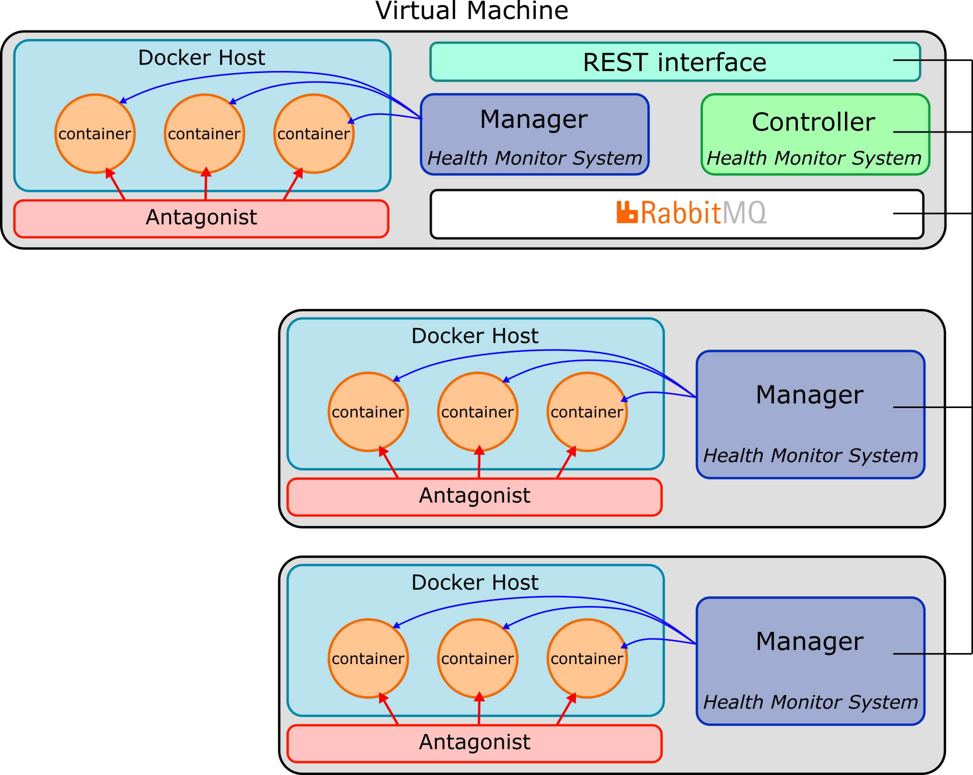
System design
Health Monitoring System (HMS) architecture
Objective: Monitor the containers deployed in the VMs platform
Manager: a local submodule will check the containers status and act when a fault is detected
Controller: an overseer will manage the transmission of monitoring logs and commands in the system
Communication: the submodules exchange information a developed message queue system based in RabbitMQ

Slide 5

System design
From the designed REST interface, the user will be able to verify the status of the containers and issue commands for the Managers configuration (pkt loss threshold and ignored IDs)
REST interface
User/admin
HMS Controller
Configuration
Monitoring log
HMS Manager
container
container
Docker Host

Slide 6
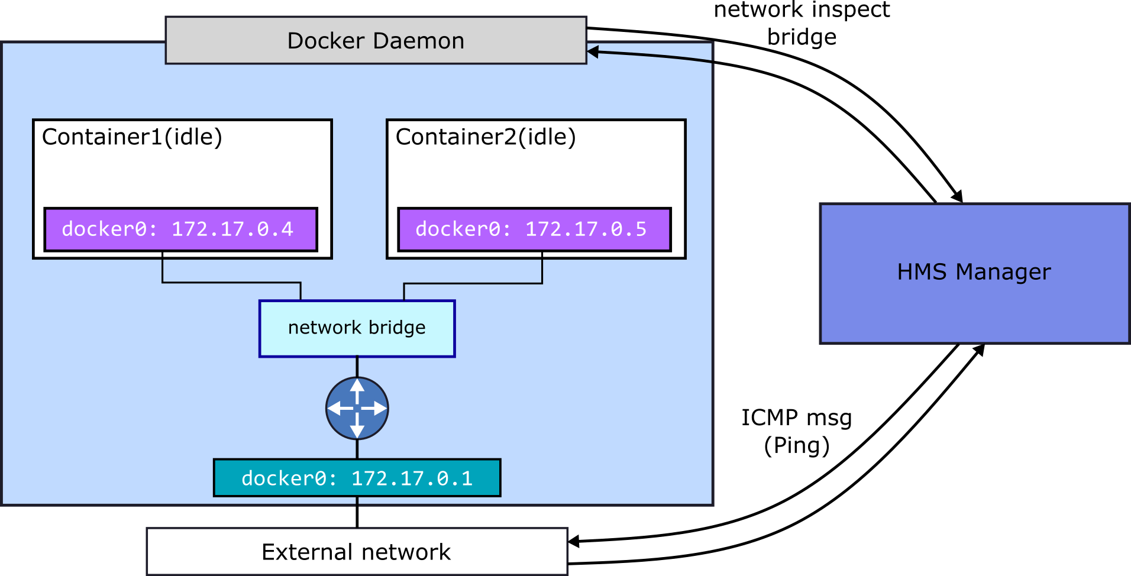
The Manager submodule
Each Manager deployed in the platform will interact with the local Docker Host daemon, retrieving a list of running containers and their status
The Manager will also interact with the docker network bridge, and will periodically send ICMP messages (Ping) to the listed containers, checking for the packet loss

Slide 7
The Manager submodule
Manager monitoring Algorithm
Get containers list
After the monitoring process, the Manager sends and update to the Controller if any container was restarted
Check if ID is in ignored List
True
False
Go to next ID
Check status
“exited”
“running”
Is container restarting?
Ping
Threshold
exceeded
False
Container OK
Restart container
Save monitoring log
Go to next ID

Slide 8
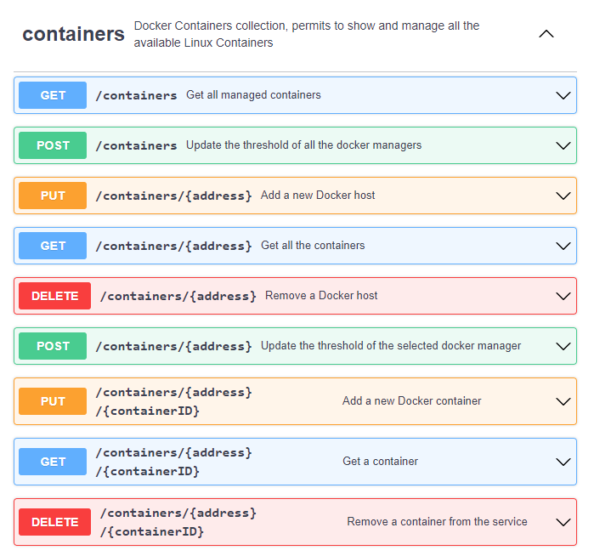
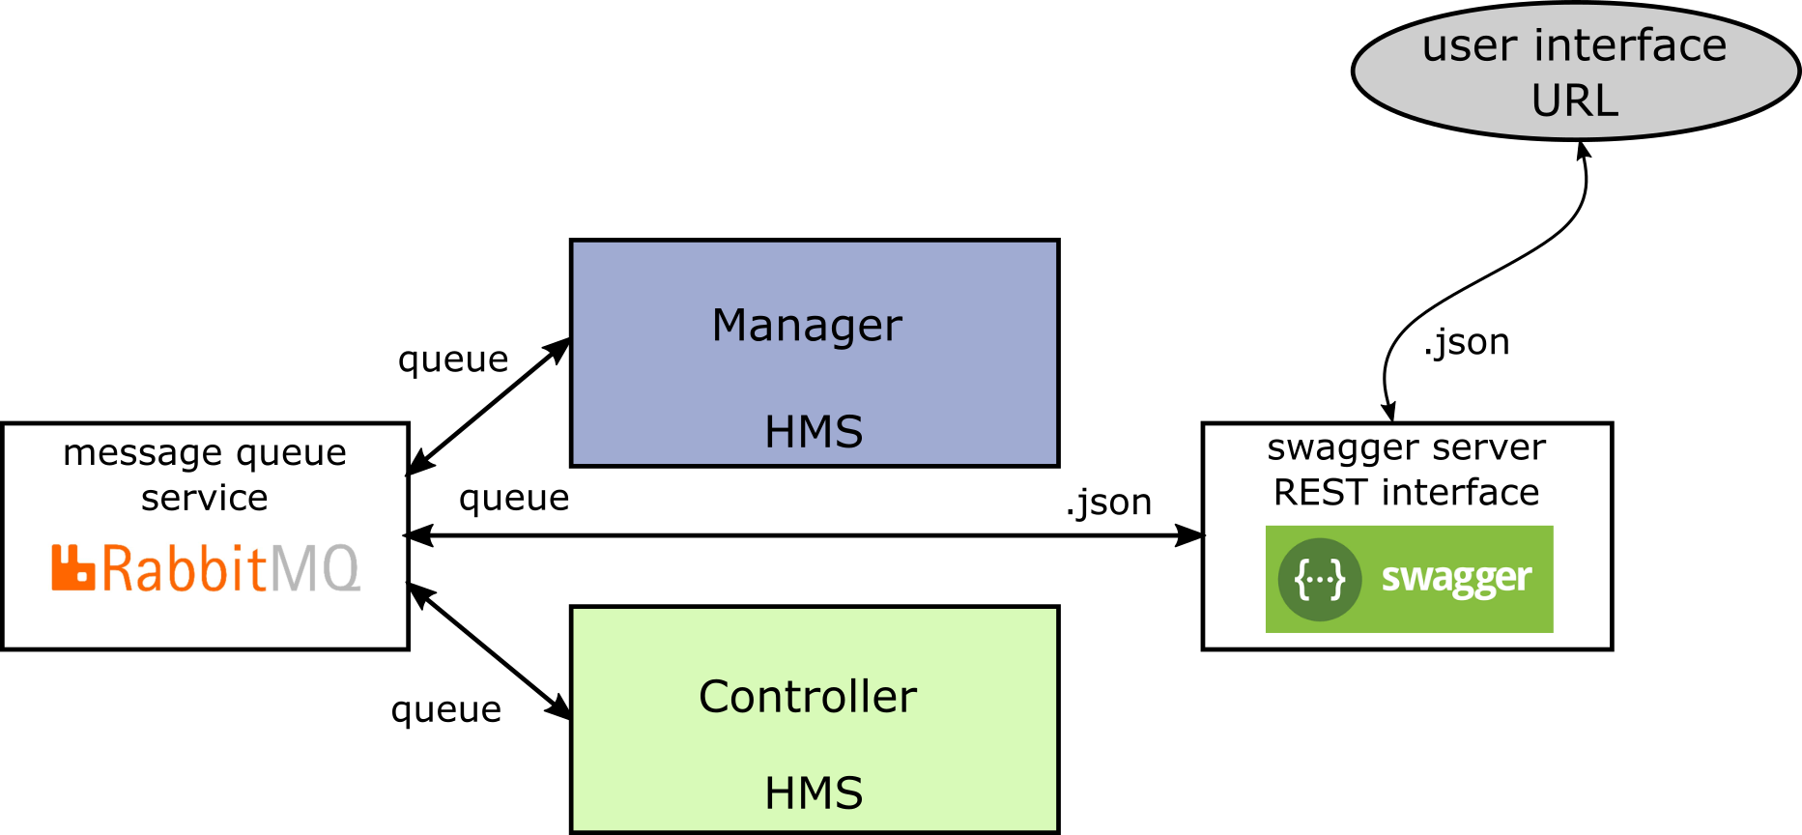
The Controller and Interface
Health Monitoring System (HMS) user interface
From the developed REST interface, the user can obtain the list of running container and their status
Also, from, the available commands, the user may set the parameters for the system monitoring, such as the packet loss threshold and the ignored containers
All this information is passed through the Controller and is transmitted using the message queue system

Slide 9

Communications

Slide 10
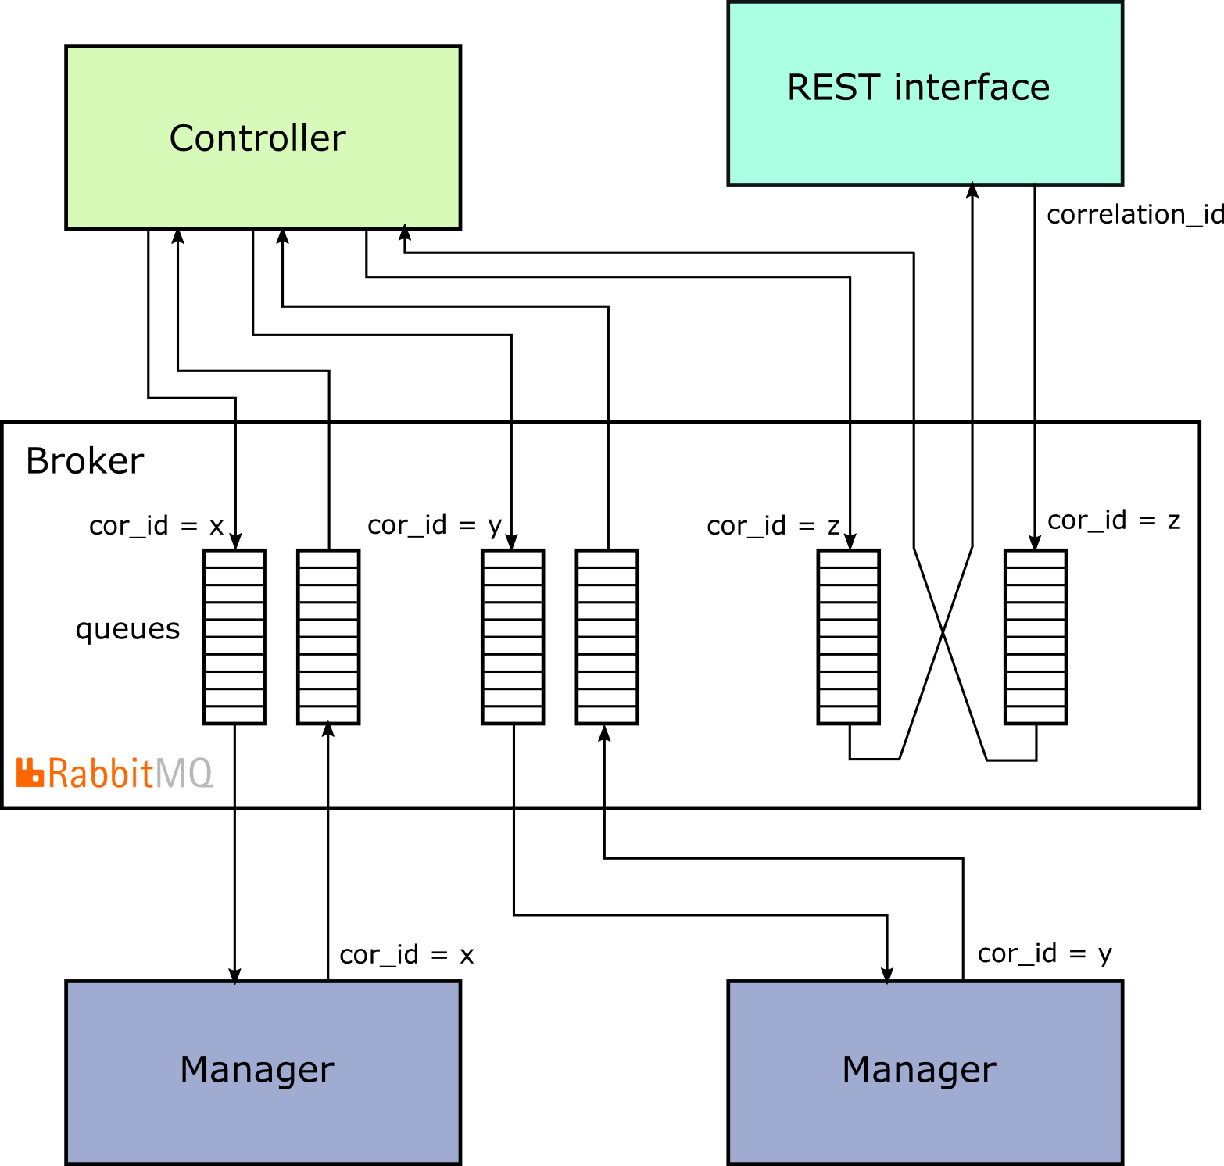
Communications Overall
Communications are based on a RabbitMQ message broker.
Clients are implemented by a dedicated python class
Each RabbitMQ client consists of two different queues, one to receive the requests from other modules and the other the receive the replies to the modules' requests
Communications between the modules can be asynchronous or synchronous

Slide 11
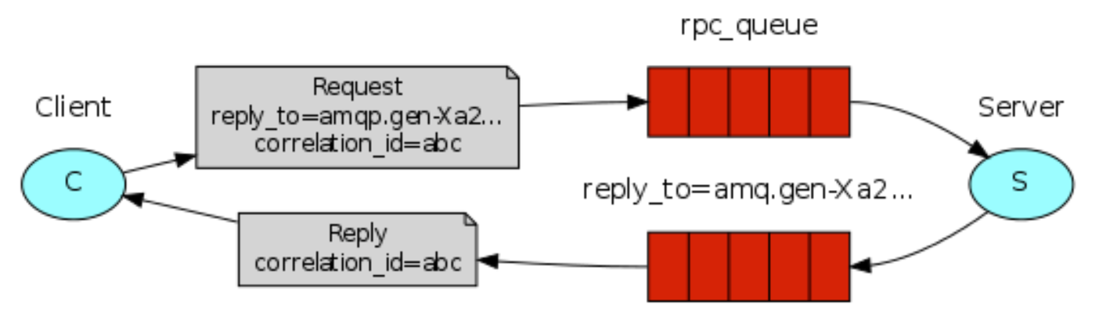
Synchronized Messaging
To implement the synchronous communications, we have used a mechanism based on a callback channel
The callback channel is used to receive the reply to a request
Each request and reply have a correlation id associated which is used from the client to forward the response to the correct requesting thread

Slide 12

Optimizations

Slide 13
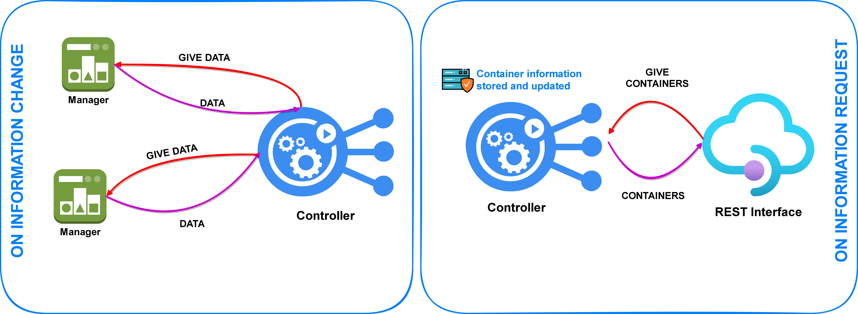
Asynchronous Information Update
To increase system performance, it is important to avoid involving as many components as possible
For the containers information we have introduced a caching mechanism to permit to the controller to respond directly to the requests without involve all the running managers
The controller is responsible for keeping an up-to-date copy of all the containers information in an asynchronous manner

Slide 14
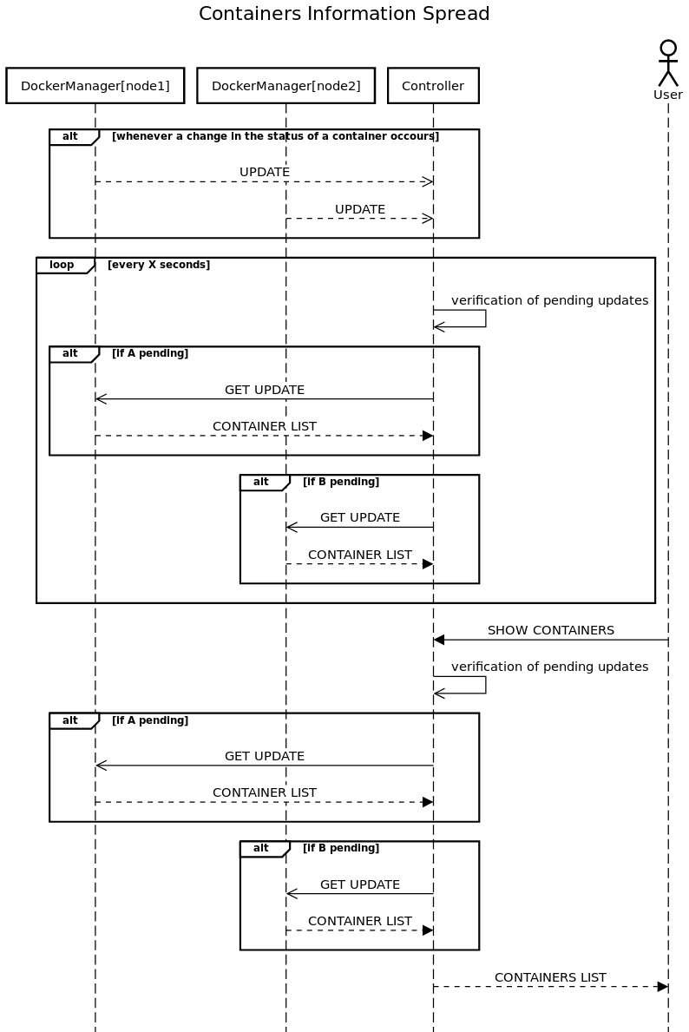
Update Management
For testing purpose, we have decided to implement an aggregation mechanism for the updates management
Updates will be sent by the Managers
The Controller tracks the Managers with pending updates
After a defined period, the Controller requests the monitoring log
The Controller updates the REST interface
with the container list and info

Slide 15

Testing

Slide 16
Antagonist
The antagonist module is designed to attack the containers using two possible methodologies:
Shutdown a container
Introduce a packet loss on the container
Five different configuration parameters available:
Heavy: defines the probability of performing an attack
Balance: defines the balance between the shutdown and the packet loss attack
Duration: defines the mean duration of the packet loss attack
Frequency: defines the mean waiting time between two attack trials

Slide 17
Testing phase
With the mechanism introduced before we can generate a more or less reactive service basing on the update monitor's period
However we expect that the more reactive the system is the more bandwidth will be consumed by the service
With the testing phase we wanna find the best period in order to keep the service available keeping at the same time the bandwidth usage contained
Heavy | Loss | Duration | Balance | Frequency
25 | 80 | 5 | 70 | 5
25 | 80 | 5 | 70 | 1
90 | 80 | 20 | 70 | 5
90 | 80 | 20 | 70 | 1
Low heavy
Low frequency attack
Low heavy
High frequency attack
High heavy
Low frequency attack
High heavy
High frequency attack
Tested aggregation times: 0.1s, 1s, 2.5s
Greaters aggregation times makes the test predictable

Slide 18
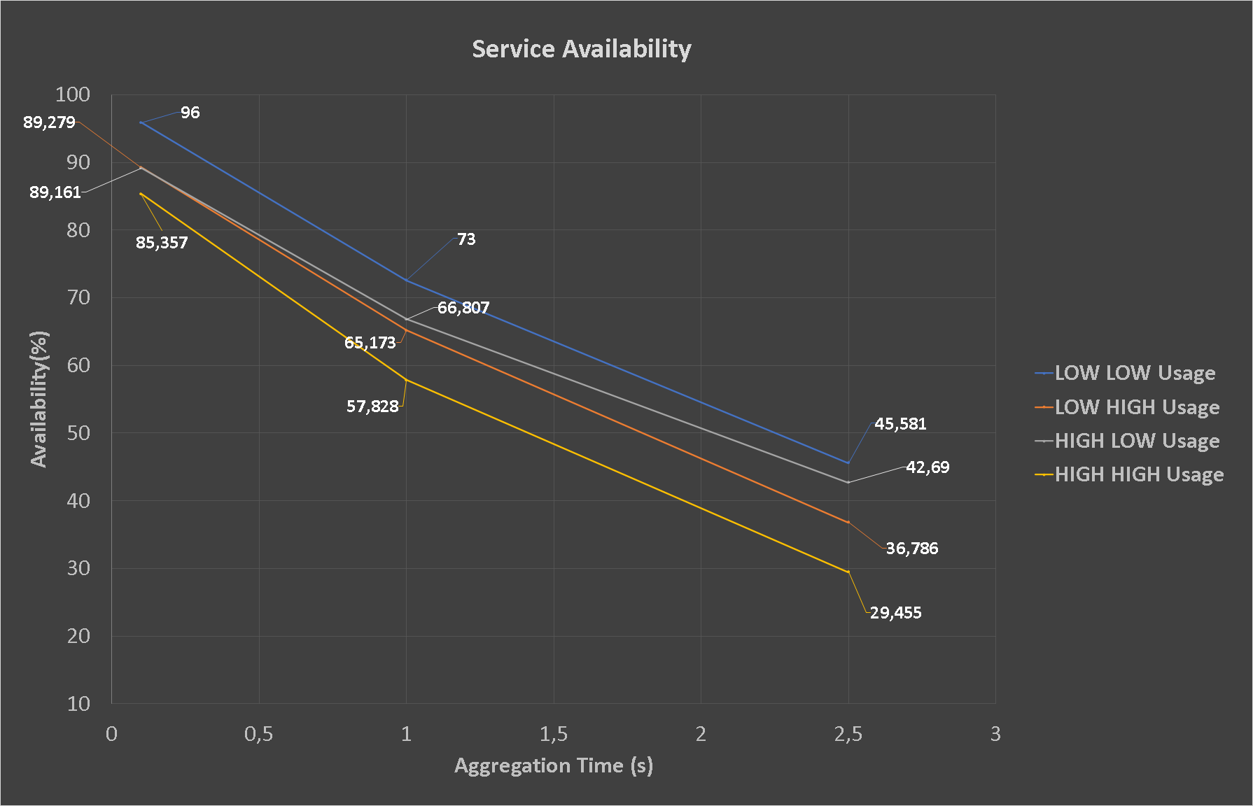
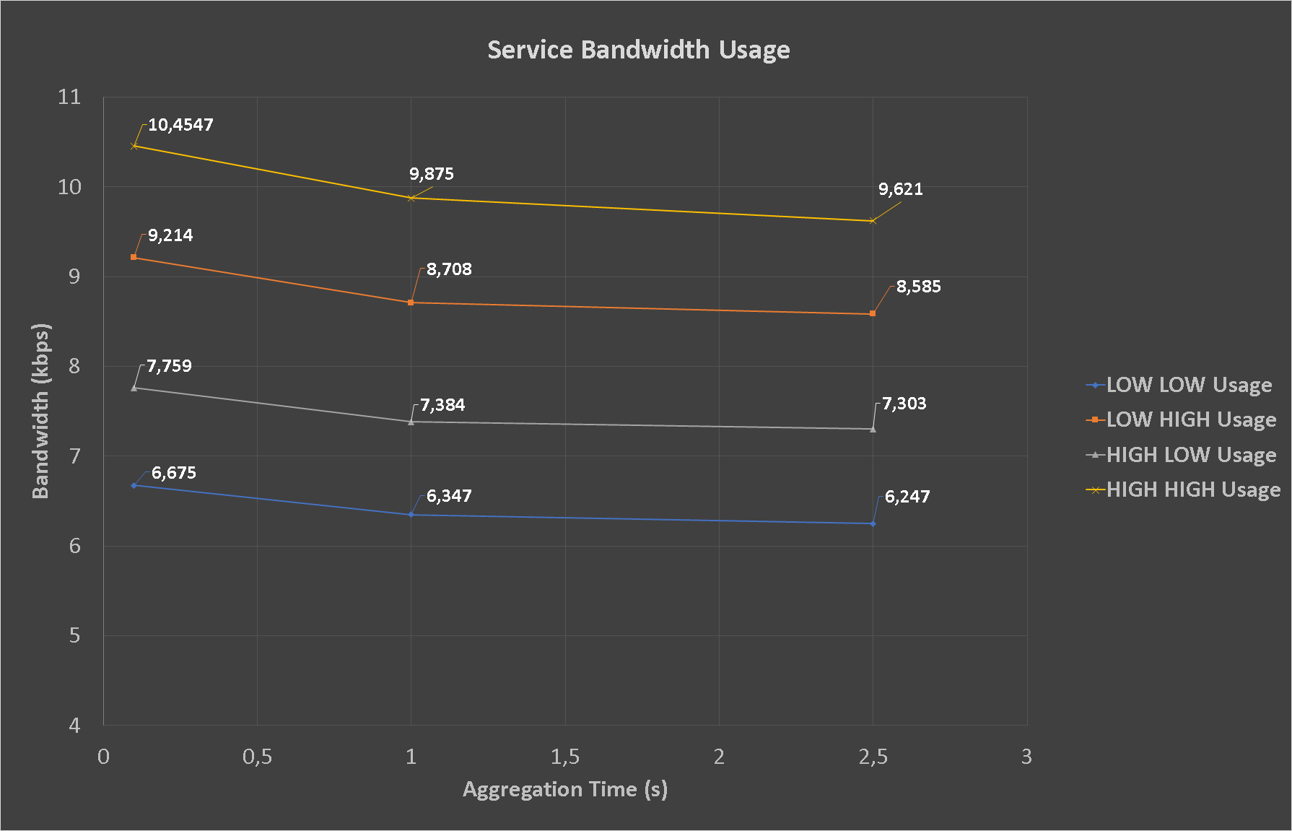
Results
How expected, during attacks the update monitor period have a big impact on the availability of the system
With monitor period greater than 1s the system became poorly available
The monitor period has a low impact on the consumed bandwidth
Halve the monitor period produces an increment of less then the 5% of the bandwidth usage

Slide 19
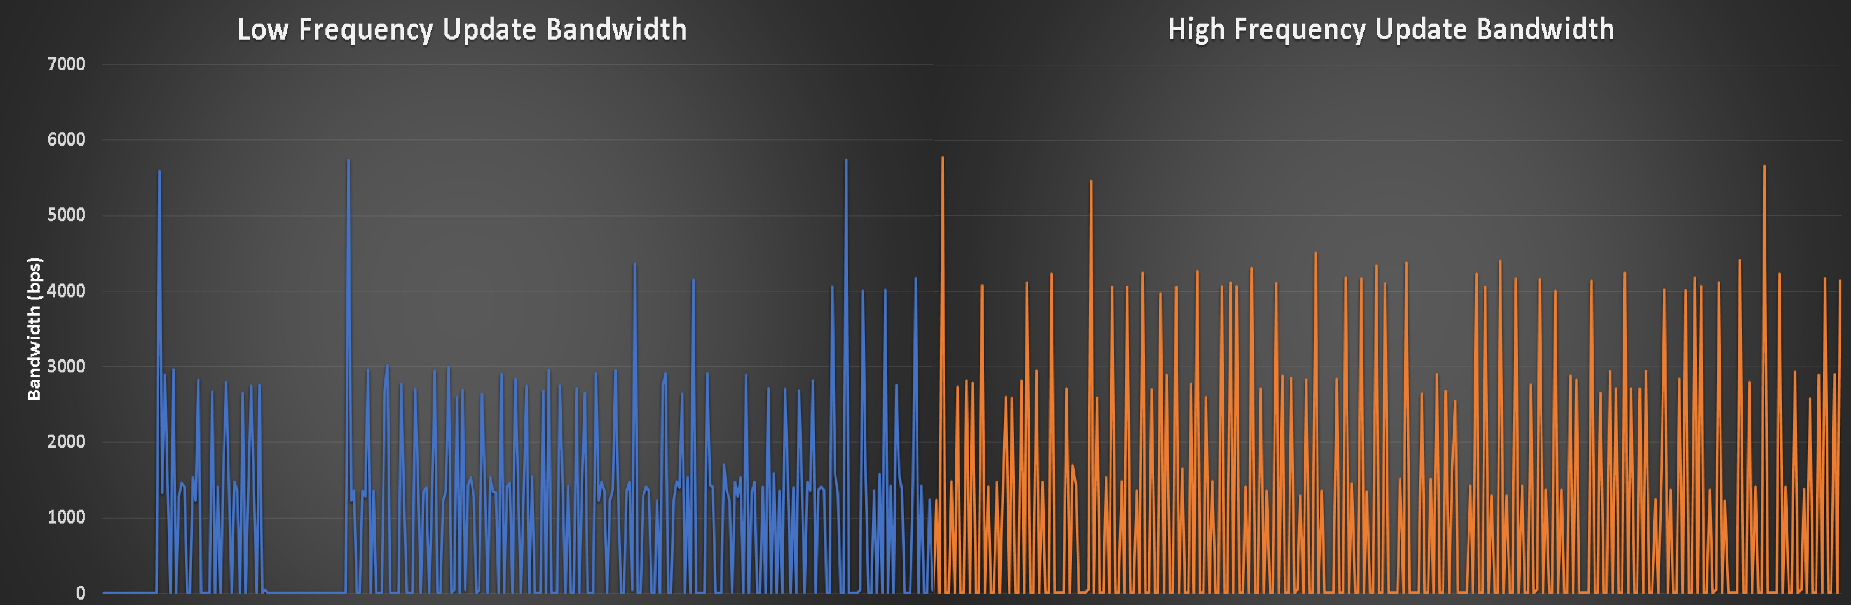
Peak Generation
A particular trend which we have considered important is the bandwidth's behaviour. This because we have to consider:
The bandwidth is measured with an aggregation of the mean byte per seconds during the time. This aggregation hides what happens inside the system
For the most of the time the bandwidth is equal to zero, so the mean value can be produced by very high sporadic peaks which even if they are rare could be a problem on the system overall

Slide 20
Conclusions
After the testing of the overall system the results has showed us that to optimized the system in case of attacks we need to keep the monitor's period less then 0.5s. This because the reducing of the period produced big increments into the availability of the system and at the same time doesn’t produce an exasperation of the service communications
Future Improvements
The deployed system is able to manage in a scalable way a set of docker hosts. However there are a set of improvements that can be added in future releases to the service:
More parallel controllers/rest interfaces can be added and integrated quickly into the service to gain more robustness
Implementing an anycast communication between the rest interface and the controllers can highly increase the availability of the service
Implementing a more efficient multicast communication between the controller and the managers can produce a more performant service

Slide 21


